Slide 1
Procrastination Station
Blake Welch, Brendan Dubach, Ethan Borrowman, James Gall, Muhannad Aljomaee

Slide 2
Overview
Introduction
Current System
Project Requirements
Mockups
Resources Allocation

Slide 3
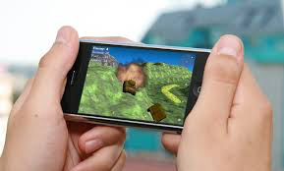
Purpose
Quick and easy entertainment
Random games
Hundreds of possibilities

Slide 4
Scope of system
The system will be confined to the smartphones
Andoid
iOS
Will use a SQL database to communicate with the Google Play Store and iOS app store

Slide 5
Objectives
Provide a platform that the user can play several free games.
Allow quick access to several top rated games without take up tons of space.
Allow the user to quickly test out games, save them if they like the game, or get rid of them if they didn’t want to.

Slide 6
Successful criteria of project
Within budget and time
User friendly for children and adults
Navigation of App is easily done
Database carries games people will actually like to play
Doesn’t take up a lot of memory
Time it takes to access game play for each game
Make sure the code works correctly and debugged

Slide 7
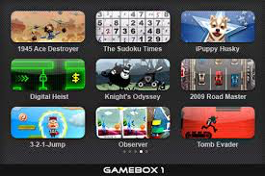
Current system
Apps Like GameBox 1 by Triniti Interactive
Limited Games, large data usage
No random selection
We want random, unlimited games, less space

Slide 8
Our Proposed System
The app will run on either an android or and iPhone smartphone device
The app will be in constant queue with our database
The database will be will be pulling the top 100 games from the respective app stores each week, refreshing its list

Slide 9
Functional Requirements
Users must be able to download games.
Users must be able to remove games.
Users must be able to play games.
App must be able to refresh the game database.

Slide 10
Non-Functional Requirements
User Friendly to all ages.
One user per phone.
Used on iphones and androids.
Database is populated by the app store.
User can restrict types of games.
Must be available 24 hours a day.
Game database is refreshed every 24 hours.
3 apps will be in queue for play

Slide 11
Tools
http://www.lucidchart.com

Slide 12
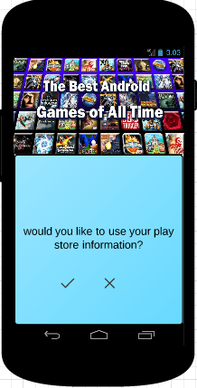
Create an account Screen
Simply the app will get the user information
from the play store
Gender
Name
Country
Age

Slide 13
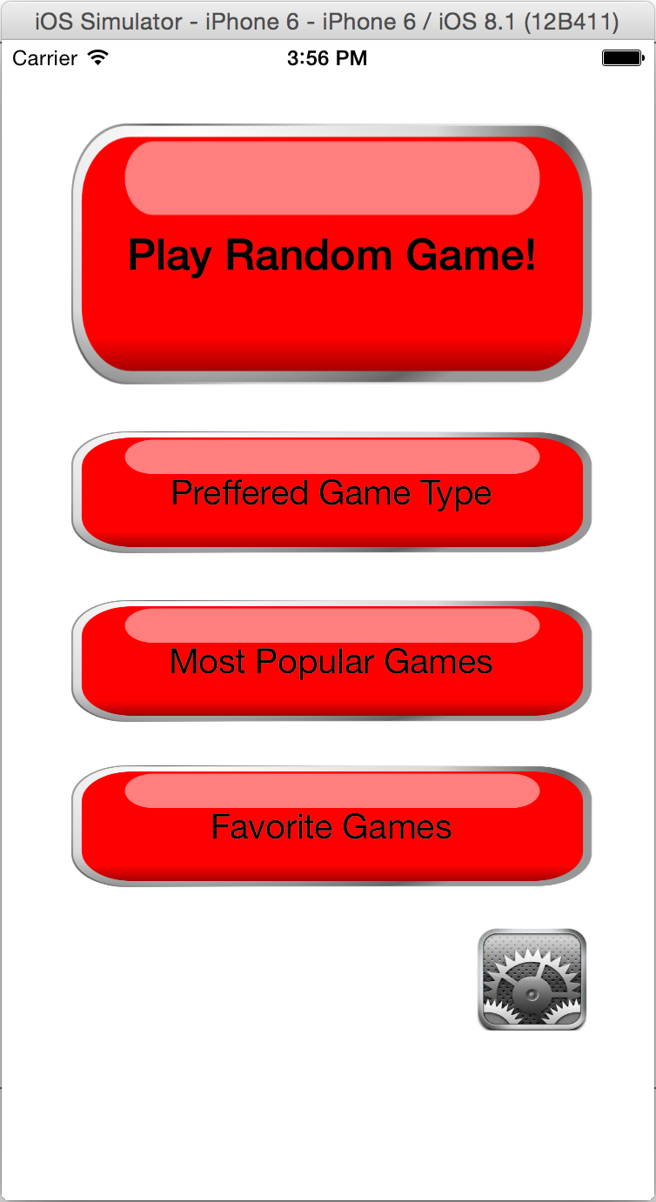
Main Screen
First screen user sees
User can
Play game
Choose game preferences
View popular games
View own favorite games
Change settings

Slide 14
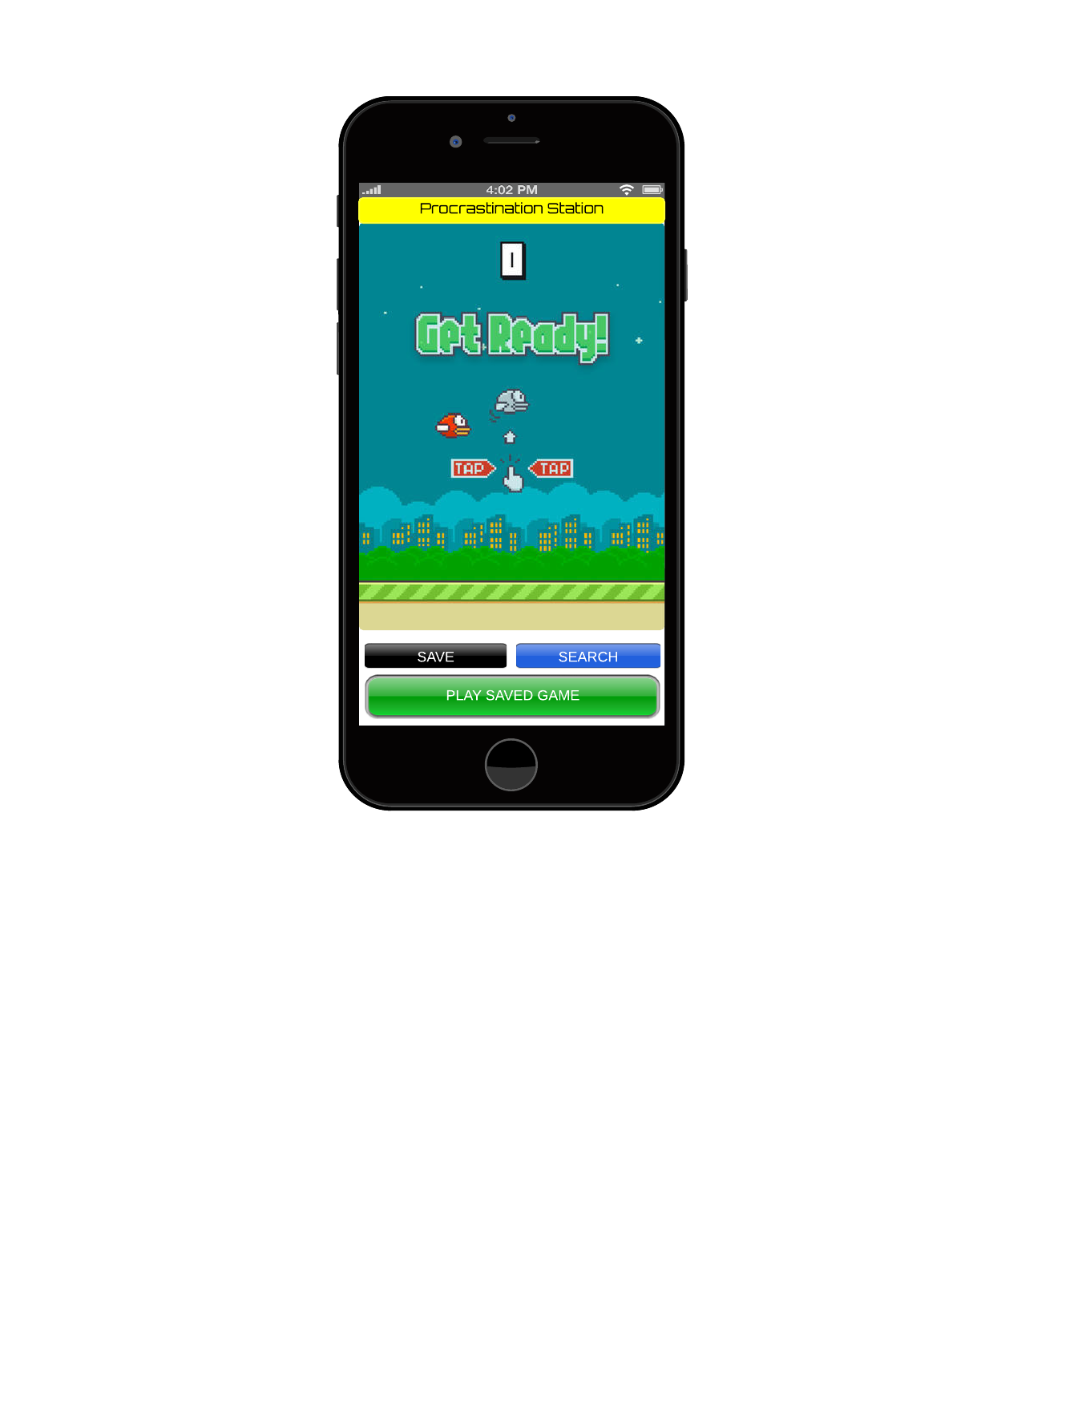
Flow of Events for Gaming Screen
Screen is opened when game is selected
Screen allows user to play the game selected
After the game is played the user must click save game button, back to search button or home button or played saved game
If the saved game or user wishes to open game; the database will open
After data is accessed or saved return to play screen

Slide 15
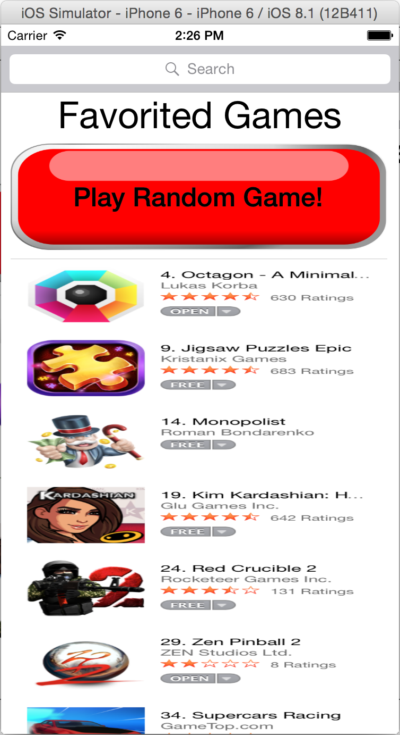
Favorite Games Screen
Shows all games user has favorited
Can play random or choose
Can search for game
Can delete favorite

Slide 16
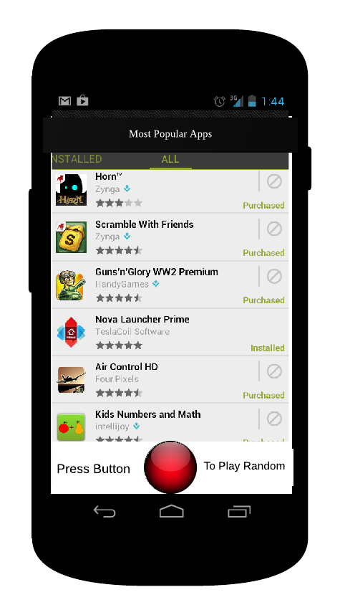
Favorites Screen
Access when user clicks favorites button on game screen
Saves game data to users sd card or internal storage
App returns a plus one to the database adding to the total of people who favorite the app
The top 50 games that are favorite are shown to the user
User can select a game or choose a random favorite by clicking random in the favorite screen

Slide 17
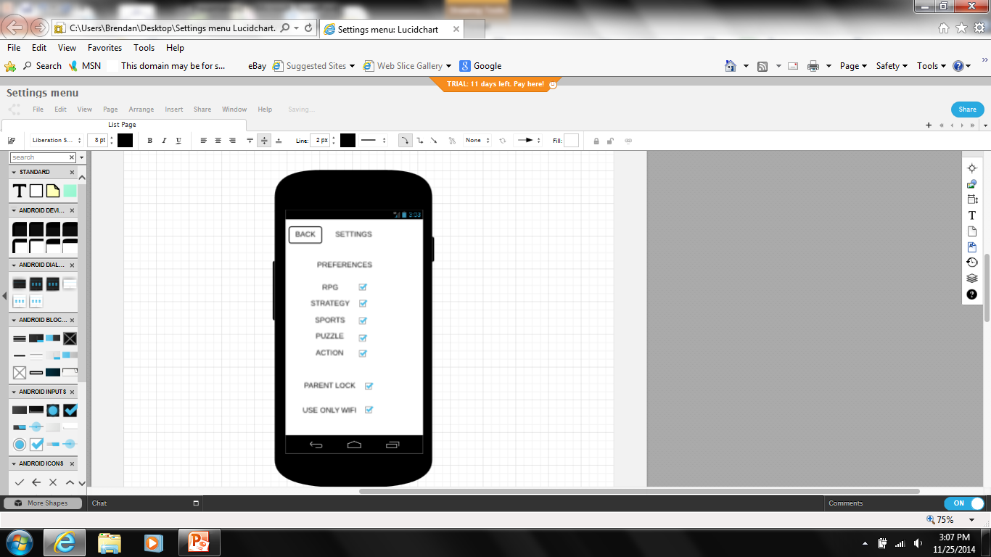
Setting Menu
Setting option (from gearbox)
Allows to change preferences
Wi-Fi
Parent Lock

Slide 18
Estimation
Budget
5 Developers
$25,000
Time
1 Month to finish Android App
2 Weeks to finish iOS App
1 Month to publish
2 Weeks (buffer time)
TOTAL=3 Months

Slide 19
Questions
?

